Slide 1
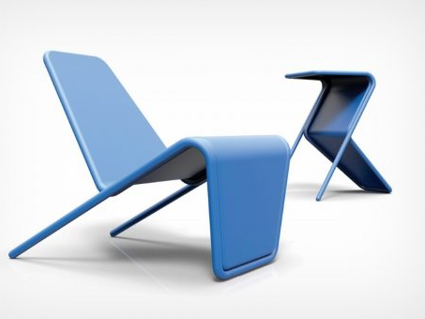
higher Design & Manufacture
Design Brief and Product Specification

Slide 2
Learning intentions & success criteria
Learning Intentions
Understand what is meant by a design brief
Understand what is meant by product specification
Success Criteria
I can explain what is meant by a design brief and give an example
I can understand how to interpret a design brief
I can explain what is meant by a product specification and can generate a list for a given product

Slide 3
Problem identification
Problem identification is:
Finding opportunities to create new designs
Finding out what needs a person or group has
To design a product to fulfil that need.
Once a problem has been identified:
It allows a designer to solve a problem
A brief can be created

Slide 4
situation analysis
Identifies problems by looking at a scene and analysing ways the situation could be improved.
Take a snap shot picture of a scene to show the problems
Describing in as much detail as possible, the things happening in the scene.
Suggest ways in which the whole situation could be improved.

Slide 5
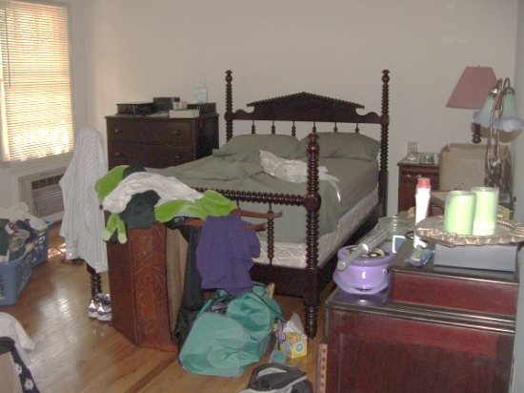
example
Situation:
Messy Bedroom
Analysis:
The untidy bedroom makes it difficult to find things or get to the bed.
Clothes and grooming items are strewn across the room
Clothes are piled near the heater which may be a fire hazard
There is limited floor space
There is nothing hanging on the wall
Possible Brief:
Design a storage wall mounted systems that would allow a variety of items to be stored neatly.

Slide 6
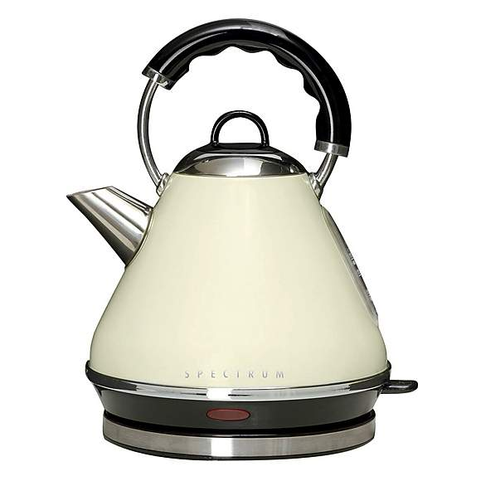
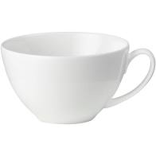
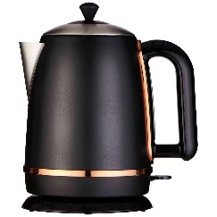
Methods of identification
Example of an existing issue:
Kettle with handle above spout
When pouring this kettle, the steam will rise up and potentially injure your hands
A better solution to this might be placing the handle at the rear/side, to avoid injury.
Product Evaluation
Product evaluation tests existing products and tries to find weaknesses in the product’s design.
All aspects (Design Factors) of the product will be looked at including function and performance, durability, material choice, manufacturing and assembly methods, ergonomics, aesthetics, and economics.
Once a weakness has been found, a brief can be created to allow the designer to redesign and improve the product.

Slide 7
Design brief what is a design brief?
A design brief is the first point of contact between the client and the designer.
It is important that it does the following;
Provides a clear summary of a problem or situation requiring a new or improved product or service.
Outlines the requirements of a solution.
Clearly indicates the target market.
Where will the product be used?

Slide 8
Design brief who creates a design brief?
It is usually written by a client who has a design problem which needs solved.
Sometimes it is written by the designer to help them focus their ideas and creativity.

Slide 9
Design brief analysing the design brief
The designer needs to explore the design brief to ensure they fully understand the task.
This is called analysing the design brief.

Slide 10
Design brief open and closed
Open Design Brief:
Outlines a problem or situation which is relatively general and open to interpretation.
Can have a wide range of acceptable solutions.
Closed Design Brief
More specific and will direct the designer towards the client’s wants.
This approach can be very restrictive to the designer and often prevents them from being innovative with their solutions.

Slide 11
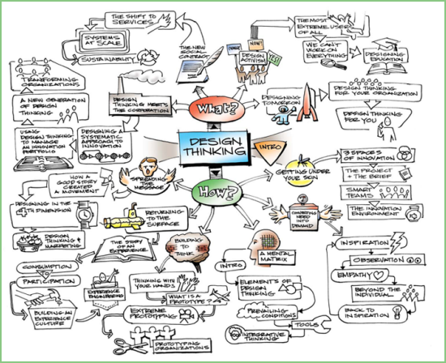
Design brief analysing the design brief
Ways to analyse a design brief:
Mind Maps
Create a mind map in order to explore different aspects of the brief, such as aesthetics, environment and economics.
Ask a Series of Appropriate Questions
Where will it be used and/or stored?
Are there any aesthetics characteristics of the range or company?
Are there any economic restrictions?
Are there any functional restrictions?
What effects or consequences will the solution have on the environment?

Slide 12
Design brief analysing the design brief
Ways to analyse a design brief:
Mind Maps
Create a mind map in order to explore different aspects of the brief, such as aesthetics, environment and economics.
Ask a Series of Appropriate Questions
Where will it be used and/or stored?
Are there any aesthetics characteristics of the range or company?
Are there any economic restrictions?
Are there any functional restrictions?
What effects or consequences will the solution have on the environment?

Slide 13
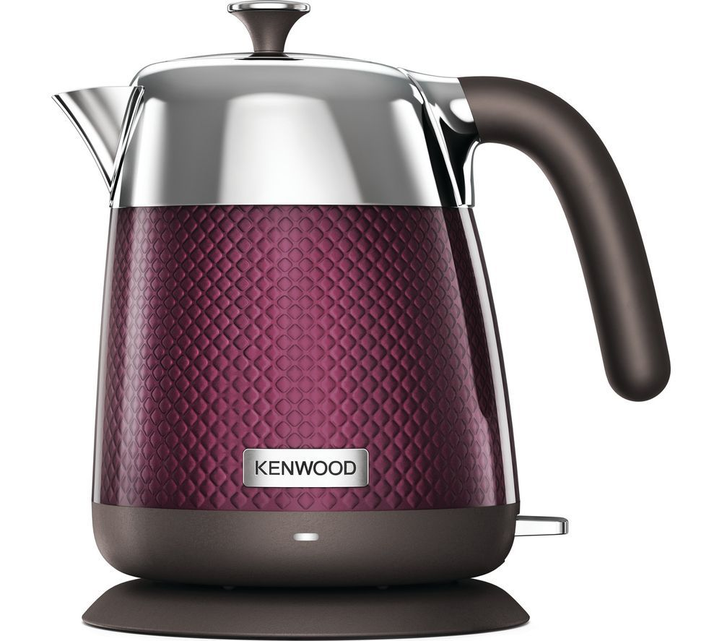
Product specification what is it?
A design specification is a list of ‘rules’ that a product must fulfil in order to be successful.
For example: For a kettle to be successful it must:
Boil water
Have a suitable sized handle
Must not be too heavy when it is full
Must be made from a material that does not conduct heat to the exterior
Be easy to fill with water
Be easy to pour water
Be easy to clean and maintain
And so on…

Slide 14
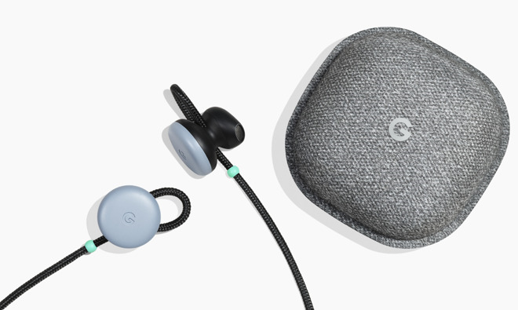
Product specification why create a specification?
When designing a product it is important to make a list of things the product must do.
This list will act as a rulebook or checklist as designers work through the design process.
Throughout the design process, designers must make several decisions and they must always be justified.
There must always be a logical reason for making a design decision and they must adhere to the points in the specification.

Slide 15
Product specification writing a specification
Look at each design area individually and ask yourself the question ‘in order for my design to be a success it must…’ for example:
What must my design do in order to Function properly?
What requirements do I have of the Materials?
What requirements do I have of the Manufacturing Process?
What would my design have to look like in order to be Aesthetically pleasing for the customer?
What must by product do in order for it to be Safe to use?
How much must my product Cost in order for people to be able to afford it?
?
?
?
?
?
?

Slide 16
Product specification how to create one
How are you going to create a design specification for A design brief?
Create a strategy of how you will conduct research
Will you consult anthropometric data?
Will you conduct a survey to see where most people want a product for, the colours they prefer, their favourite material?
Will you create a focus group?
Once you have gathered evidence from your research, you can then display this and justify your choice.
These choices then become your specification.

Slide 17
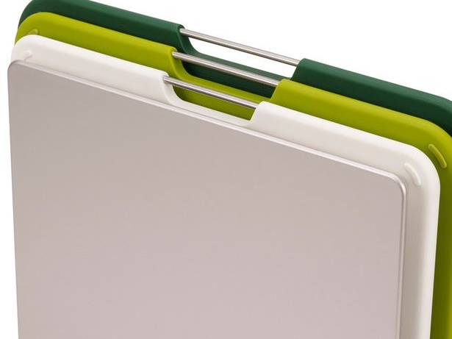
Product specification what must you consider?
Before you start the research you should have read the instructions and familiarised yourself with:
The design brief
The skills which you have to demonstrate
The type of evidence you have to provide
You must:
Identify the environment in which the product will be used
Identify additional issues required for the specification
Carry out research
Complete the specifications list
Carry out primary and secondary research

Slide 18
Product specification sqa guidelines
Research is worth 5 marks:
You must record your evidence for this skill on your research pro forma sheets.
You should research given issues and any others you identify as important for your task.
You must generate evidence using primary and secondary research methods.
Your research must be relevant to your chosen brief.
Your research must produce information that can be included in the specification.
Your research evidence may be in the form of sketches, notes, text, graphs or pictures.
Specification is worth 3 marks:
You must add your specification points to the specification on the pro forma.
Your specification should cover a range of issues.
Your specification should include enough detail to help you develop a proposal.

